Slide 1
Trees & Biomes
Salvatore Giambrone

Slide 2
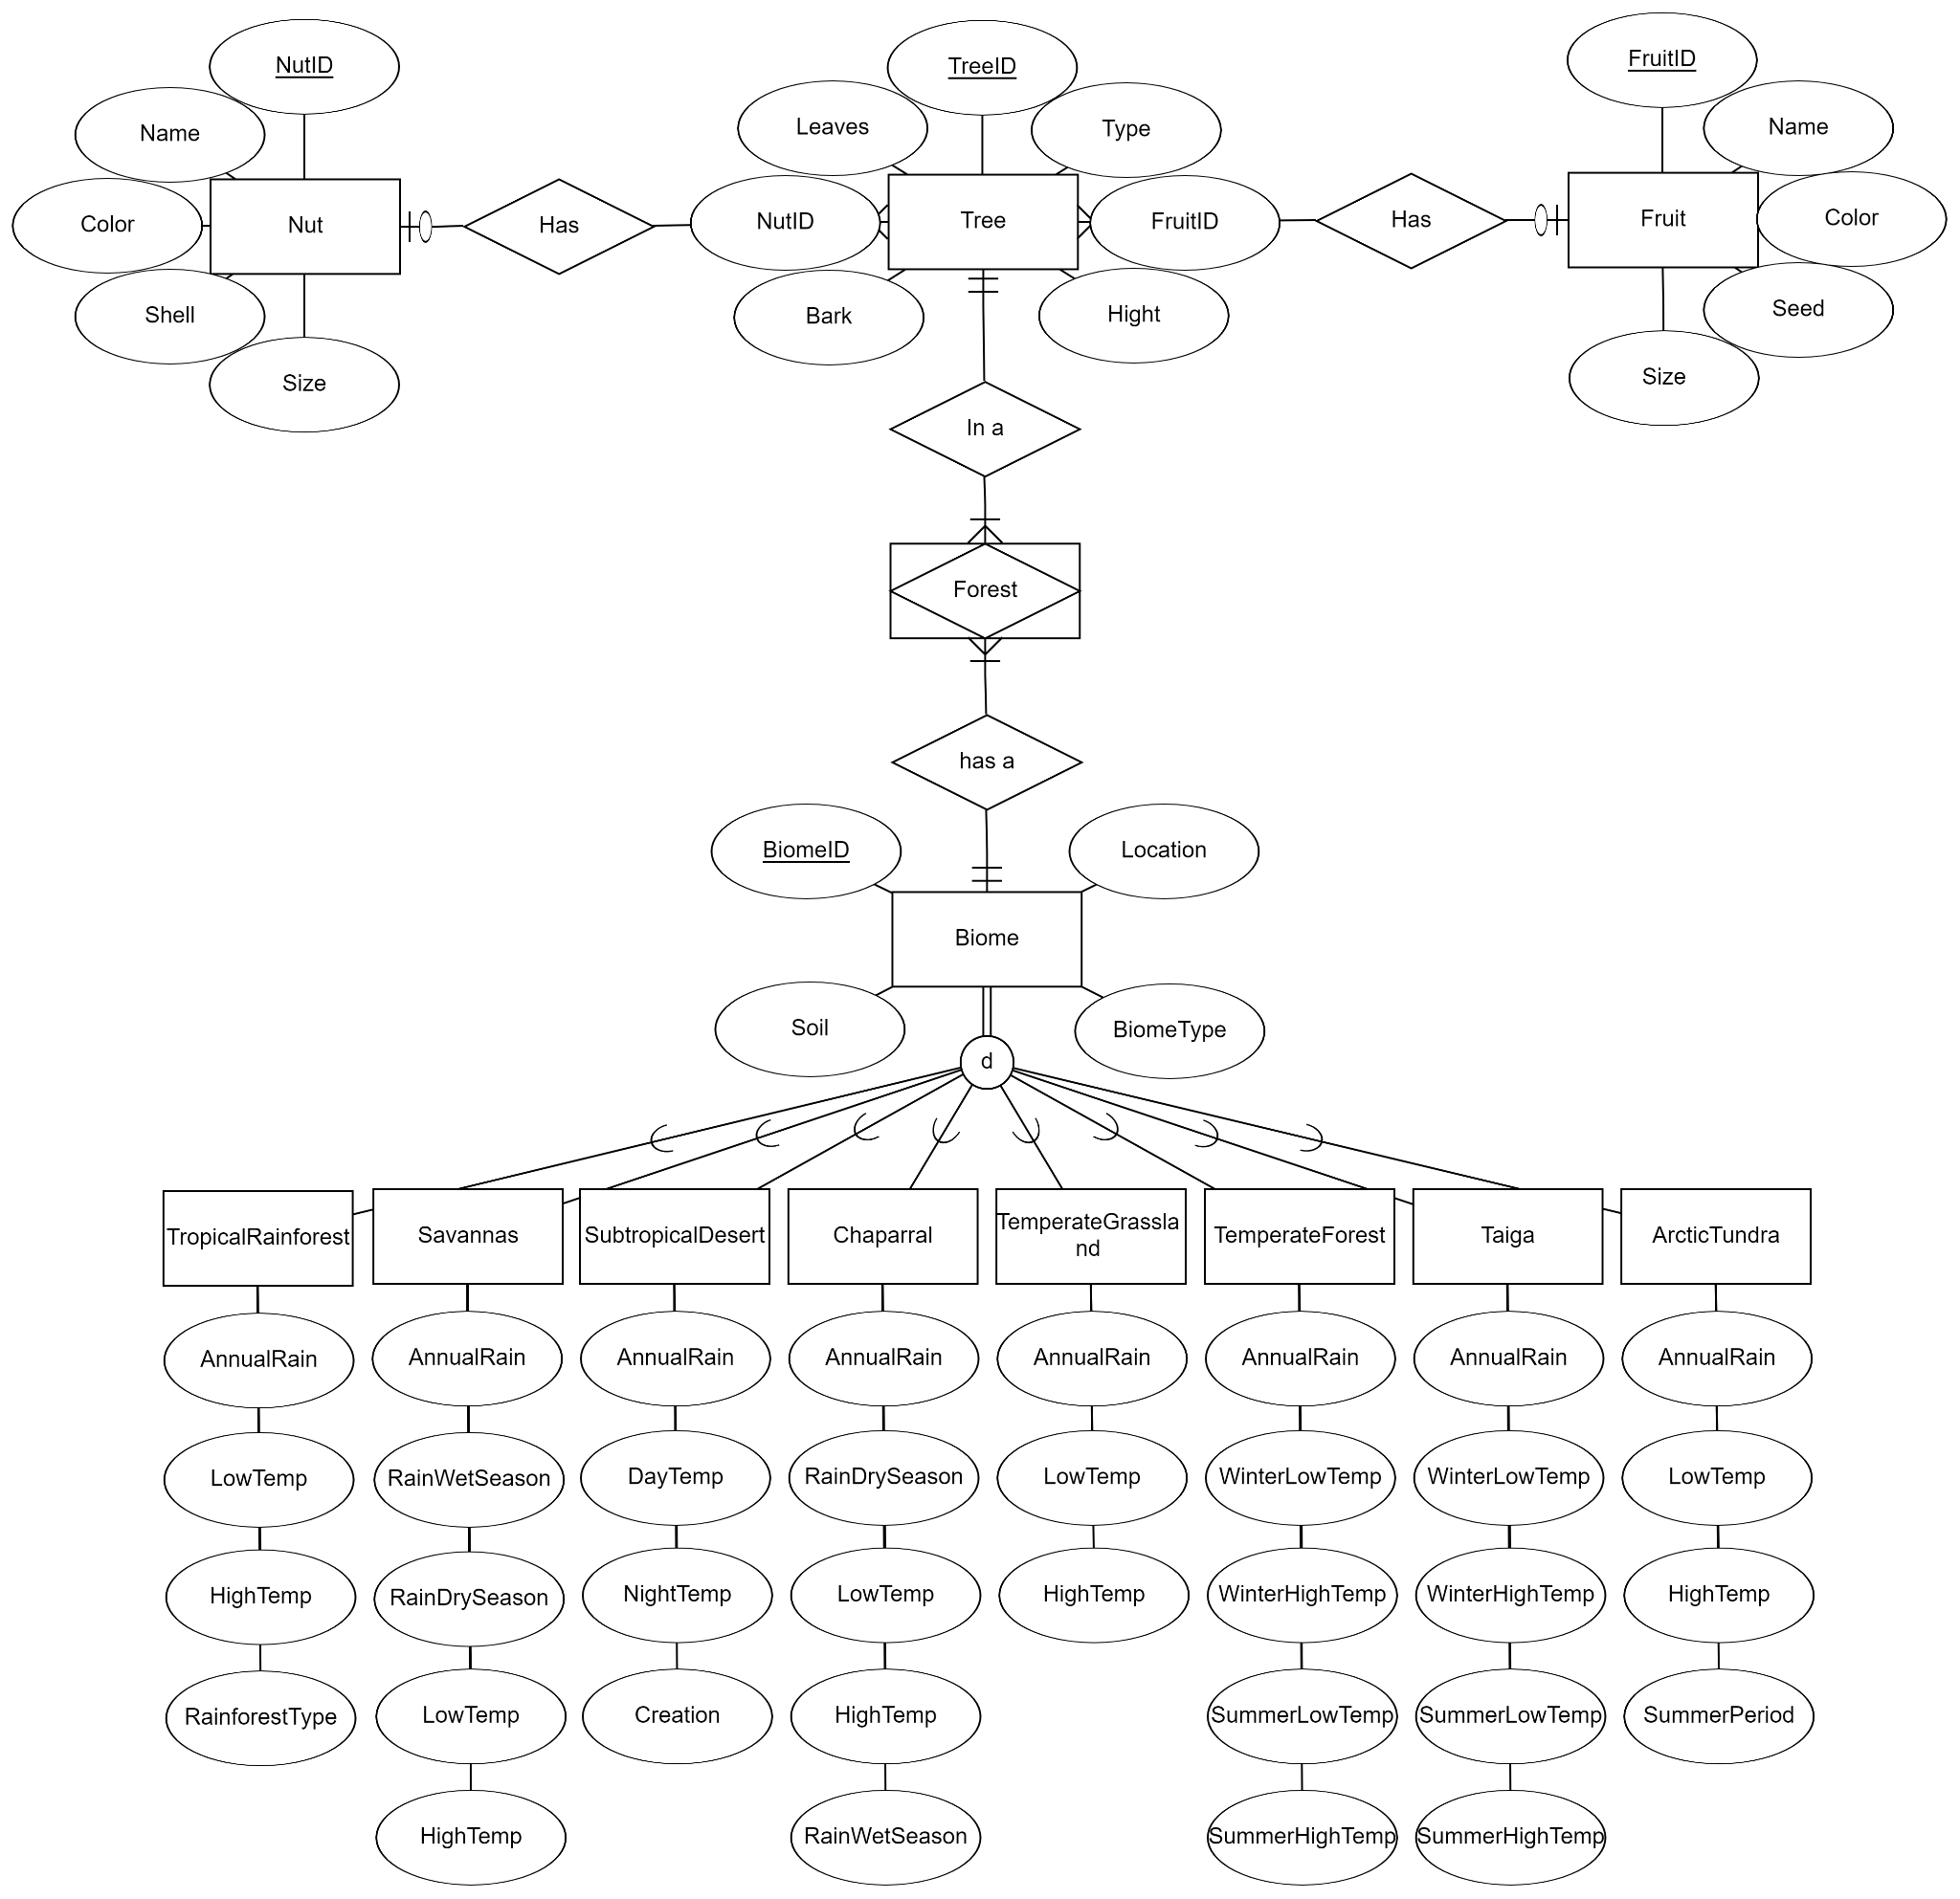
Overview
Made up of two sections:
Tree section
Biome section

Slide 3
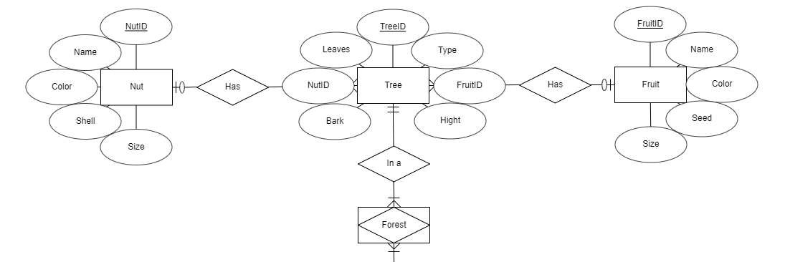
Tree Section

Slide 4
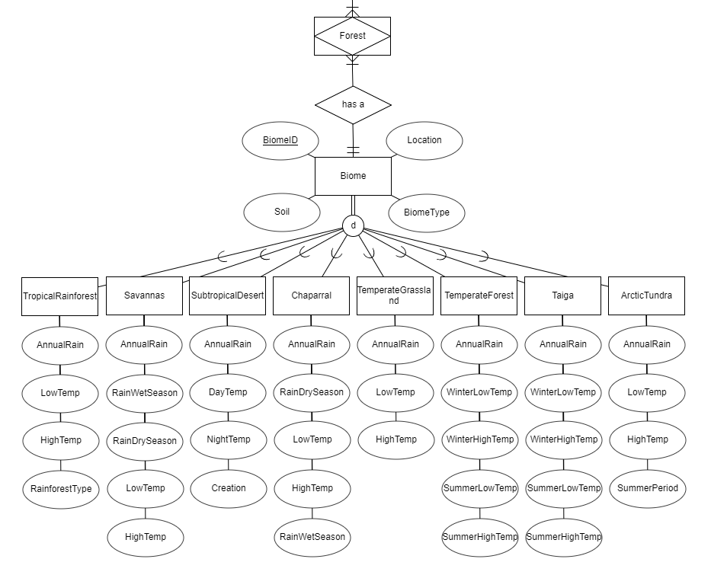
Biome Section

Slide 5
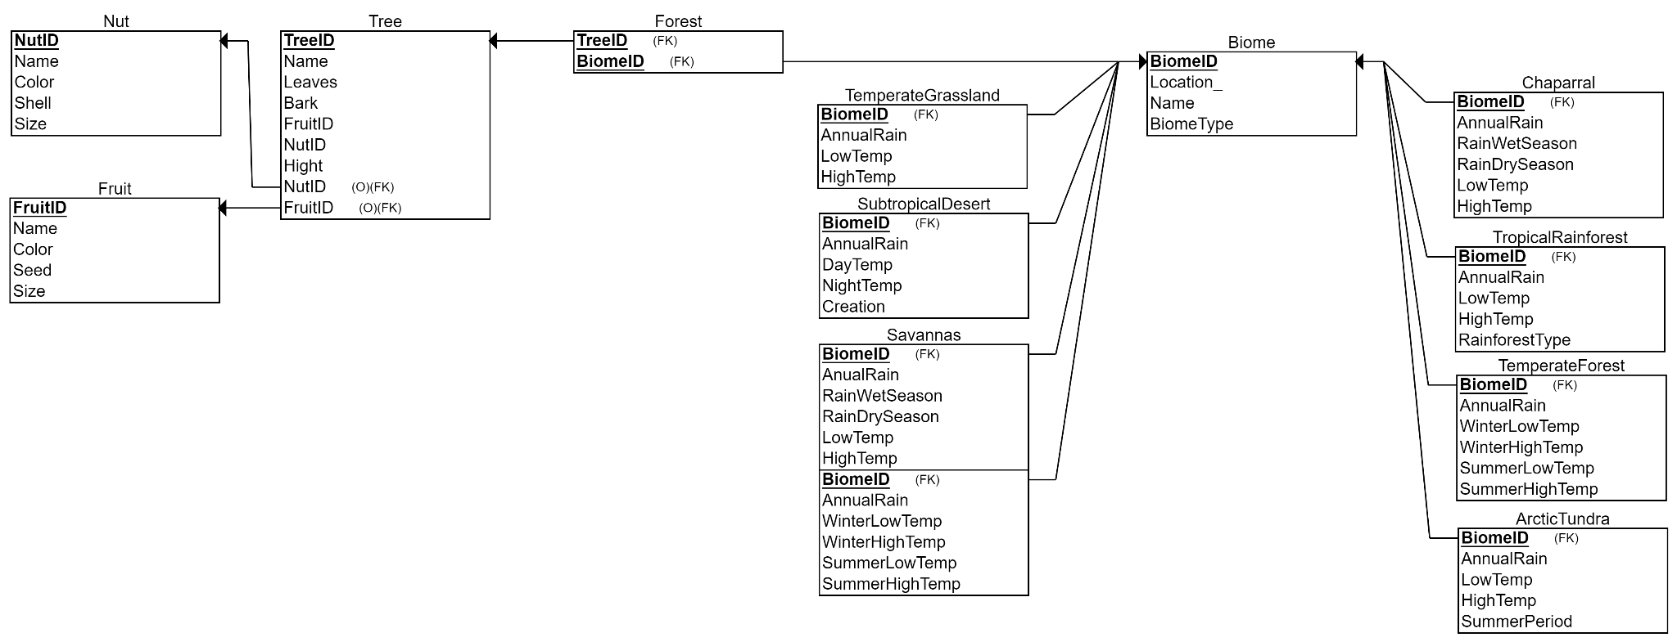
Relational Schema

Slide 6
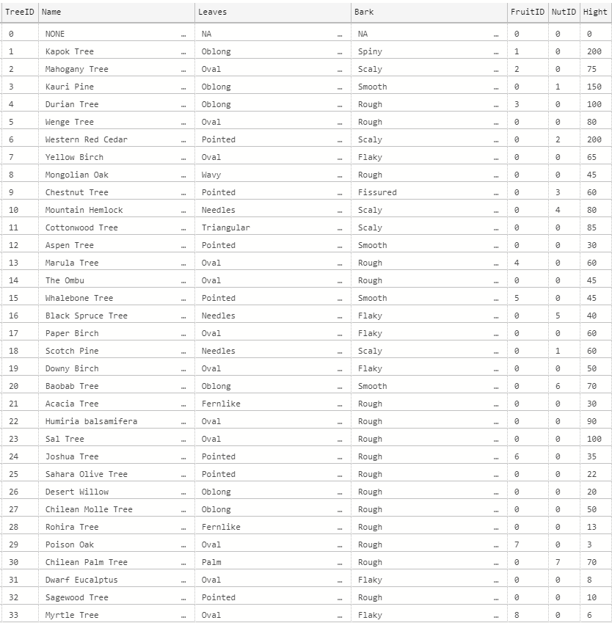
Tree Data

Slide 7
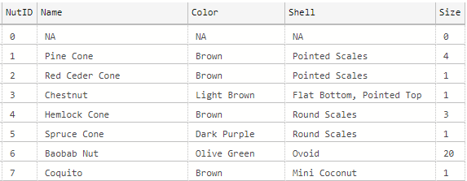
Nut Data

Slide 8
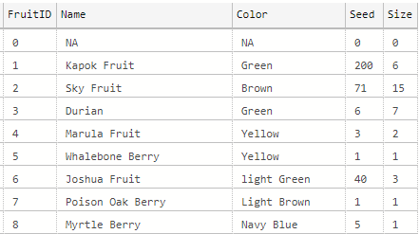
Fruit Data

Slide 9
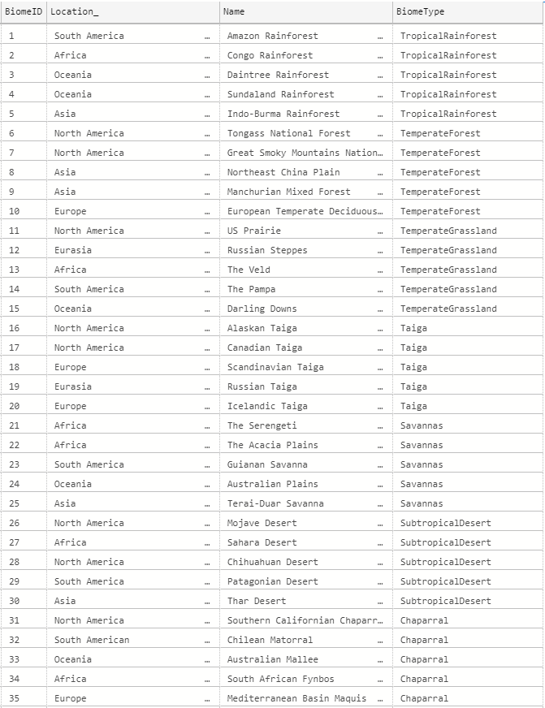
Biome Data

Slide 10
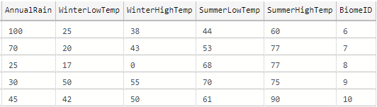
Temperate Forests Data

Slide 11
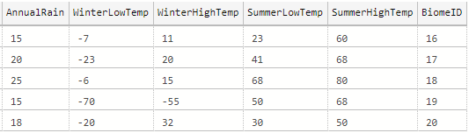
Taiga Data

Slide 12
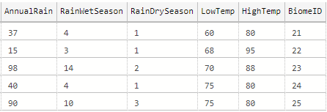
Savanna Data

Slide 13
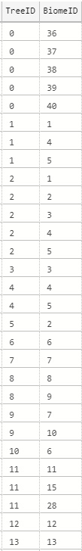
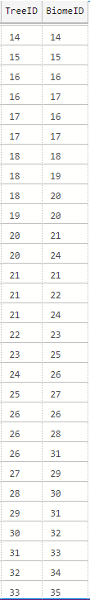
Forest Data

Slide 14
Possible Queries
What are all of the fruit producing trees in the ____ biome?
Are there any trees that live in more than one biome?
What tree does the ____ nut come from?
What trees are less than 100 feet tall?
What location and biome is the _____ tree in?
Which biome has the highest average annual rainfall?
What are the location names of the biomes in North America?

